Slide 1
AutoCad 2021
د. وميض تركي محمد

Slide 2
في نهاية هذا الدرس يستطيع الطالب أن يتعرف على:
استخدام المجموعة الثانية من ادوات الرسم Use the 2nd group of drawing tools
اختيار الوحدات Selection of Units

Slide 3
أدوات الرسم Drawing tools
Drawing Arcs : An arc is a portion of a circle. The total angle of an arc will always be less than 360 degrees, whereas the total angle of a circle is 360 degrees. AutoCAD provides you with eleven ways to draw an arc. You can draw arcs in different ways by using the tools available in the Arcs drop-down of the Draw panel. The usage of these tools will depend on your requirement.

Slide 4
أدوات الرسم Drawing tools
Drawing Splines :Splines are non-uniform curves which are used to create irregular shapes. In AutoCAD, you can create splines by using two methods: Spline Fit and Spline CV.
Specify first point or [Method Knots Object]:

Slide 5
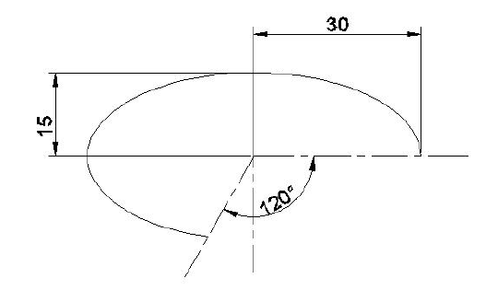
أدوات الرسم Drawing tools
Drawing Ellipses: Ellipses are also non-uniform curves, but they have a regular shape. They are actually splines created in a regular closed shape. In AutoCAD, you can draw an ellipse in three different ways by using the tools available in the Ellipse drop-down of the Draw panel.
Ellipse Specify center of ellipse:
Specify endpoint of axis:
Specify distance to other axis or [Rotation]:
Ellipse Specify axis endpoint of ellipse or [Arc Center]:
Specify other endpoint of axis:
Specify distance to other axis or [Rotation]:
Ellipse Specify axis endpoint of elliptical arc or [Center]:
Specify axis endpoint of ellipse or [Arc Center]:
Specify other endpoint of axis:
Specify distance to other axis or [Rotation]:

Slide 6
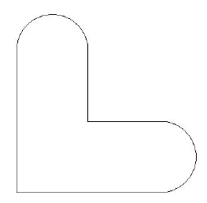
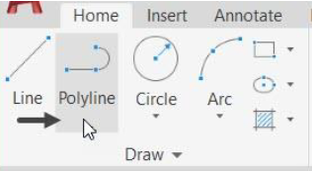
أدوات الرسم Drawing tools
Drawing Polylines : A Polyline is a single object that consists of line segments and arcs. It is more versatile than a line as you can assign a width to it.
Example:

Slide 7
-Pline: Specify start point(Select an arbitrary point in the drawing window)
-Specify next point or [Arc Halfwidth Length Undo Width]:Move the cursor horizontally
toward right and type 100. Next, press ENTER.
-Specify next point or [Arc Close Halfwidth Length Undo Width] Select the Arc option
from the command line.
-Specify endpoint of arc or [Angle CEnter Close Direction Halfwidth Line Radius Second pt Undo Width]: Move the cursor vertically upward and type 50. Next, press ENTER.
-Specify endpoint of arc or [Angle CEnter Close Direction Halfwidth Line Radius Second pt Undo Width]: Select the Line option from the command line.
-Specify next point or [Arc Close Halfwidth Length Undo Width]: Move the cursor horizontally toward left and type 50. Next, press ENTER.
-Specify next point or [Arc Close Halfwidth Length Undo Width]: Move the cursor vertically upward and type 50. Next, press ENTER.
-Specify next point or [Arc Close Halfwidth Length Undo Width]: Select the Arc option from the command line
-Specify endpoint of arc or [Angle CEnter Close Direction Halfwidth Line Radius Second pt Undo Width]: Move the cursor horizontally toward left and type 50. Next, press ENTER.
-Specify endpoint of arc or [Angle CEnter Close Direction Halfwidth Line Radius Second pt Undo Width]: Select the CLose option from the command line

Slide 8
أدوات الرسم Drawing tools
Drawing Rectangles : A Rectangle is a four-sided single object. You can create a rectangle by just specifying its two diagonal corners. However, there are various methods to create a rectangle.
Rec Specify first corner point or [Chamfer Elevation Fillet Thickness Width]: Pick a point and press Enter
Specify other corner point or [Area Dimensions Rotation]: Select the Dimensions option from the command line
Specify length for rectangles: Type 400 and press ENTER.
Specify width for rectangles: Type 200 and press ENTER.
Specify other corner point or [Area Dimensions Rotation]: Move the cursor upwards and click to create the rectangle.

Slide 9
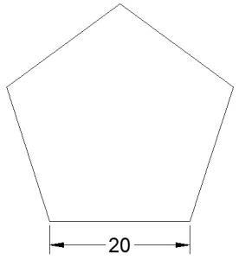
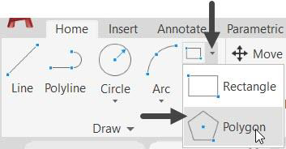
أدوات الرسم Drawing tools
Drawing Polygons :A Polygon is a single object having many sides ranging from 3 to 1024. In AutoCAD, you can create regular polygons having sides with equal length. There are two methods to create a polygon.
Polygon Enter number of sides <4>: Type 5 and press ENTER.
Specify center of polygon or [Edge]: Select the Edge option from the command line.
Specify first endpoint of edge: Select an arbitrary point.
Specify second endpoint of edge: Type 20 and press ENTER.

Slide 10
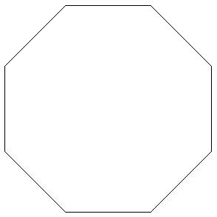
أدوات الرسم Drawing tools
Polygon Enter number of sides <5>: Type 8 and press ENTER.
Specify center of polygon or [Edge]: Select an arbitrary point
Enter an option [Inscribed in circle Circumscribed about circle] <C>: Select the Inscribed in circle option from the command line.
Specify radius of circle: Type 20 and press ENTER

Slide 11
إختيار الوحدات Selection of Units
- Application menu → Drawing Utilities→ Units
- Type Units in command bar

Slide 12
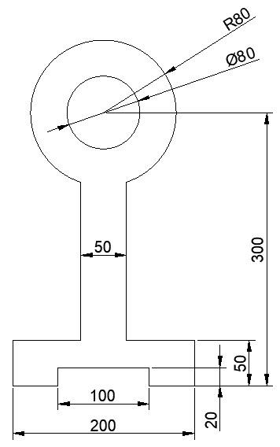
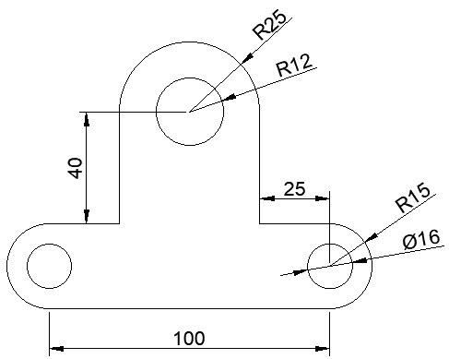
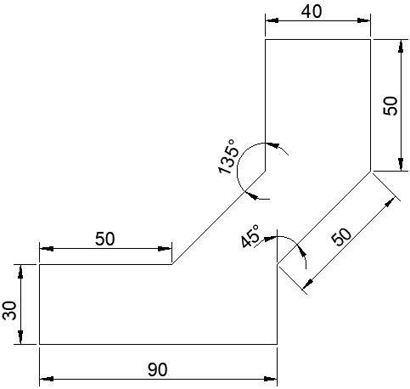
Home Work

Slide 13
الدرس القادم ... AutoCAD 2021
في الدرس القادم ... سنكمل ما تبقى من أدوات الرسم... بإذن الله
شكراً جزيلا

